Slide 1



PARiKSHA
Mentor- Dr. Gaurav Singal
Team :-
Vibhu Upmanyu - E19CSE298
Pulkit Vyas - E19CSE284
Chirag Saxena - E19CSE124
Yoshi Bansal - E19CSE332
Anushka Garg - E19CSE252

Slide 2

Outline
Introduction
The Problem
Solution
Tech Stack
Responsibilities and Contribution
Features
What’s Next?

Slide 3
PARiKSHA
We are developing a unified online platform in the form of a web application for conducting assessments, producing analytics and providing A.I. assisted proctoring facilities.

Slide 4


Problem Statement
Current facilities do not provide integrated solution
The monitoring system becomes inefficient as the number of students attempting the exams increases
Institutions that have their own servers and other infrastructure cannot cope with the increased traffic and sometimes crash due to sudden surge in number of users during exams

Slide 5
Solution
Our Proposed Solution:
AI assisted alert system
Hybrid Implementation
All under one roof (Quiz - A.I. Testing - Hybrid Implementation)

Slide 6







Tech Stack

Slide 7






Tech Stack

Slide 8
Responsibilities & Contribution
Vibhu Upamanyu : Back-end development
Chirag Saxena : Front-End development
Pulkit Vyas : Monitoring System, Hybrid Implementation
Yoshi Bansal : AI assisted alert system
Anushka : Alert System

Slide 9
FEATURES

Slide 10
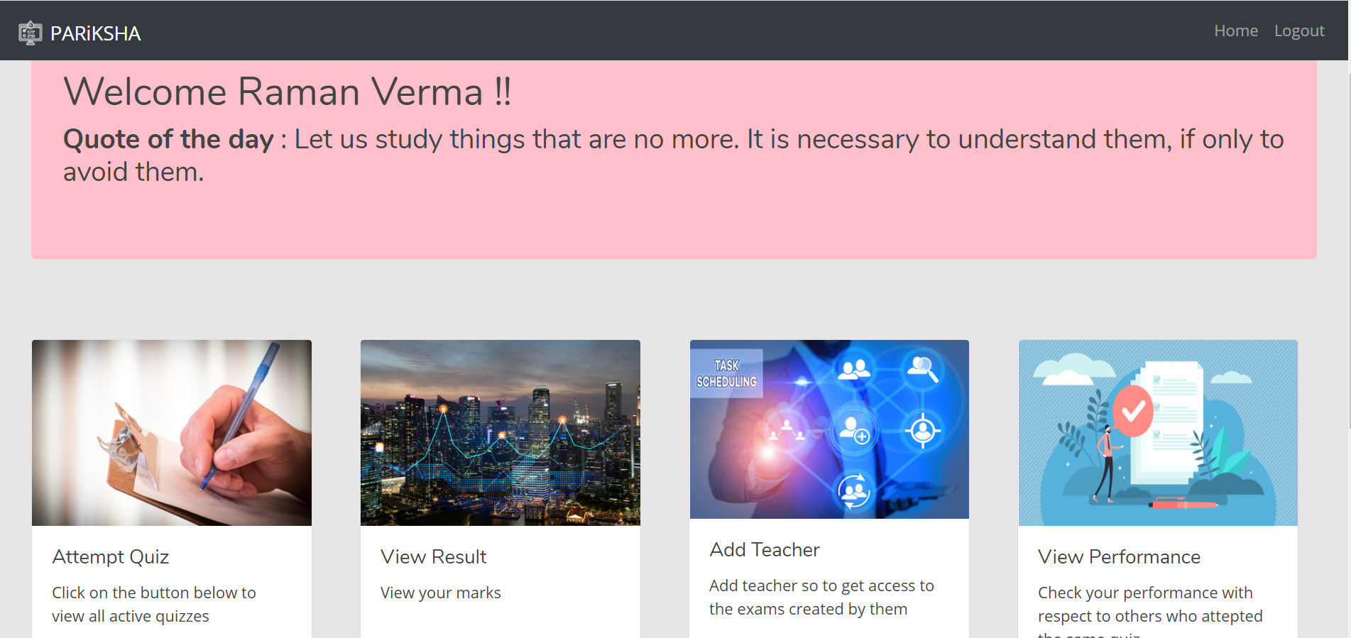
Quiz
PARiKSHA provides teachers to conduct exams online.

Slide 11
Quiz
Teacher - Can Create, Activate and Deactivate quiz accordingly.
Results are stored in a single database and readily available 24x7 for teachers and students.
Performance analysis-Students can track and analyze their performance.

Slide 12
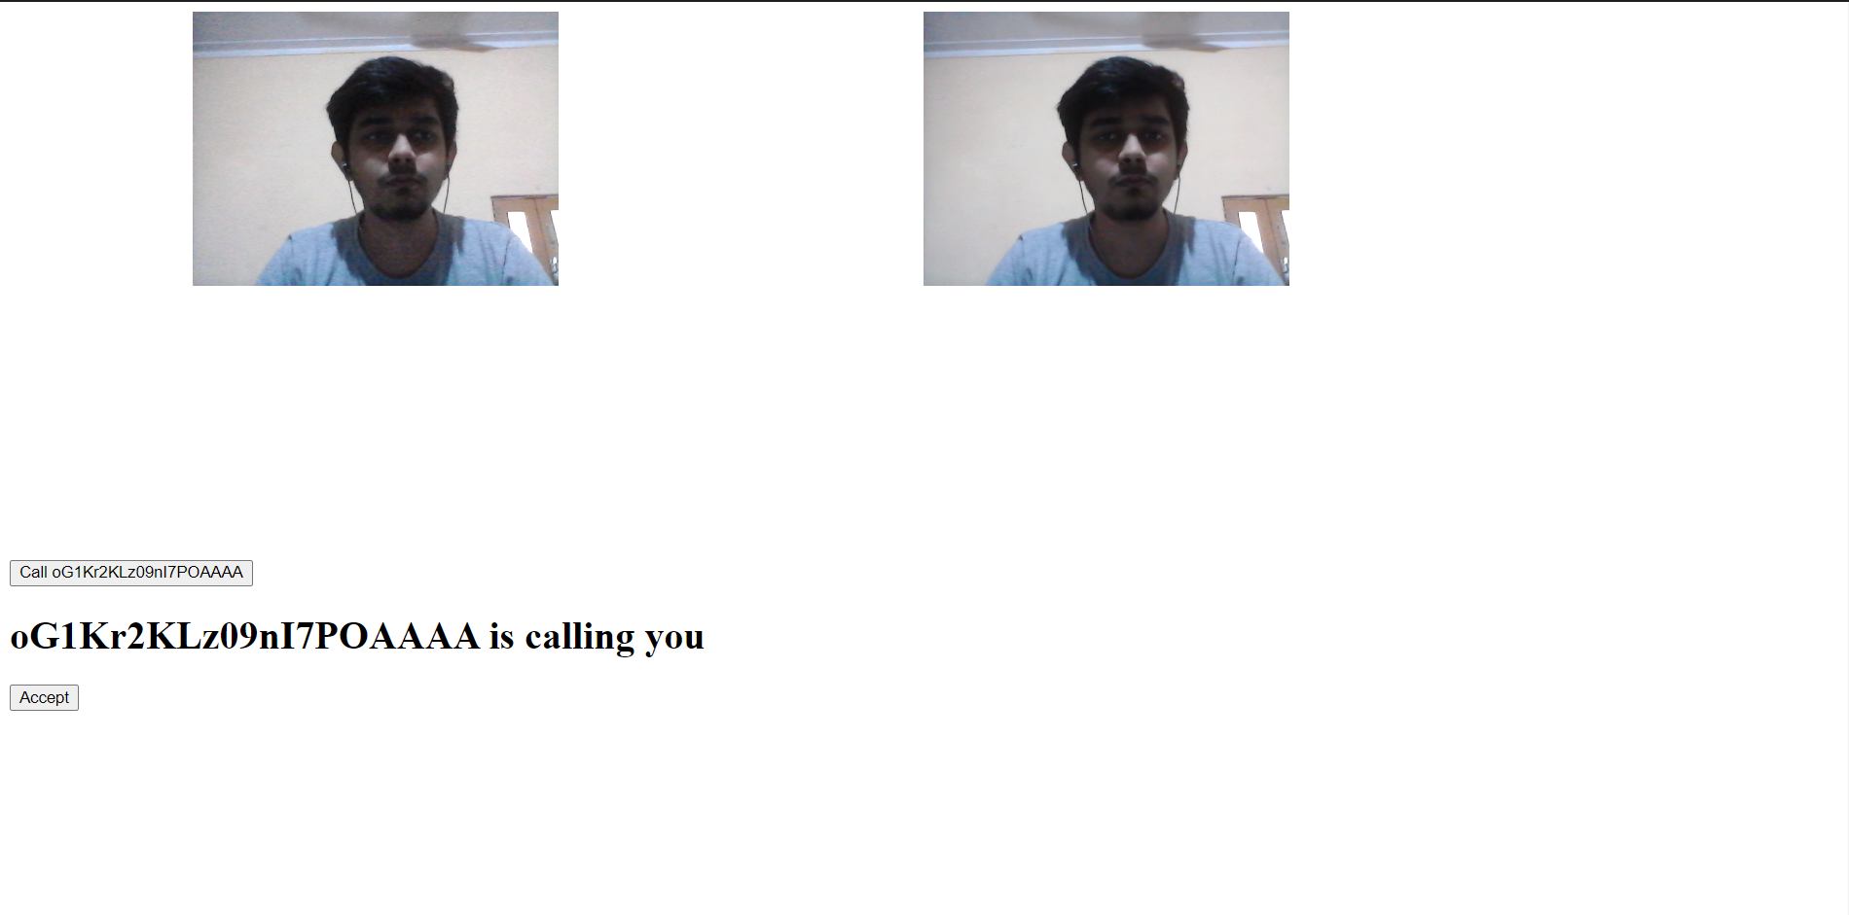
Video Monitoring System

Slide 13
Video Monitoring System
The system will allow teacher to monitor the students and also pass important instructions.
The video monitoring system will be assisted with the Alert System

Slide 14
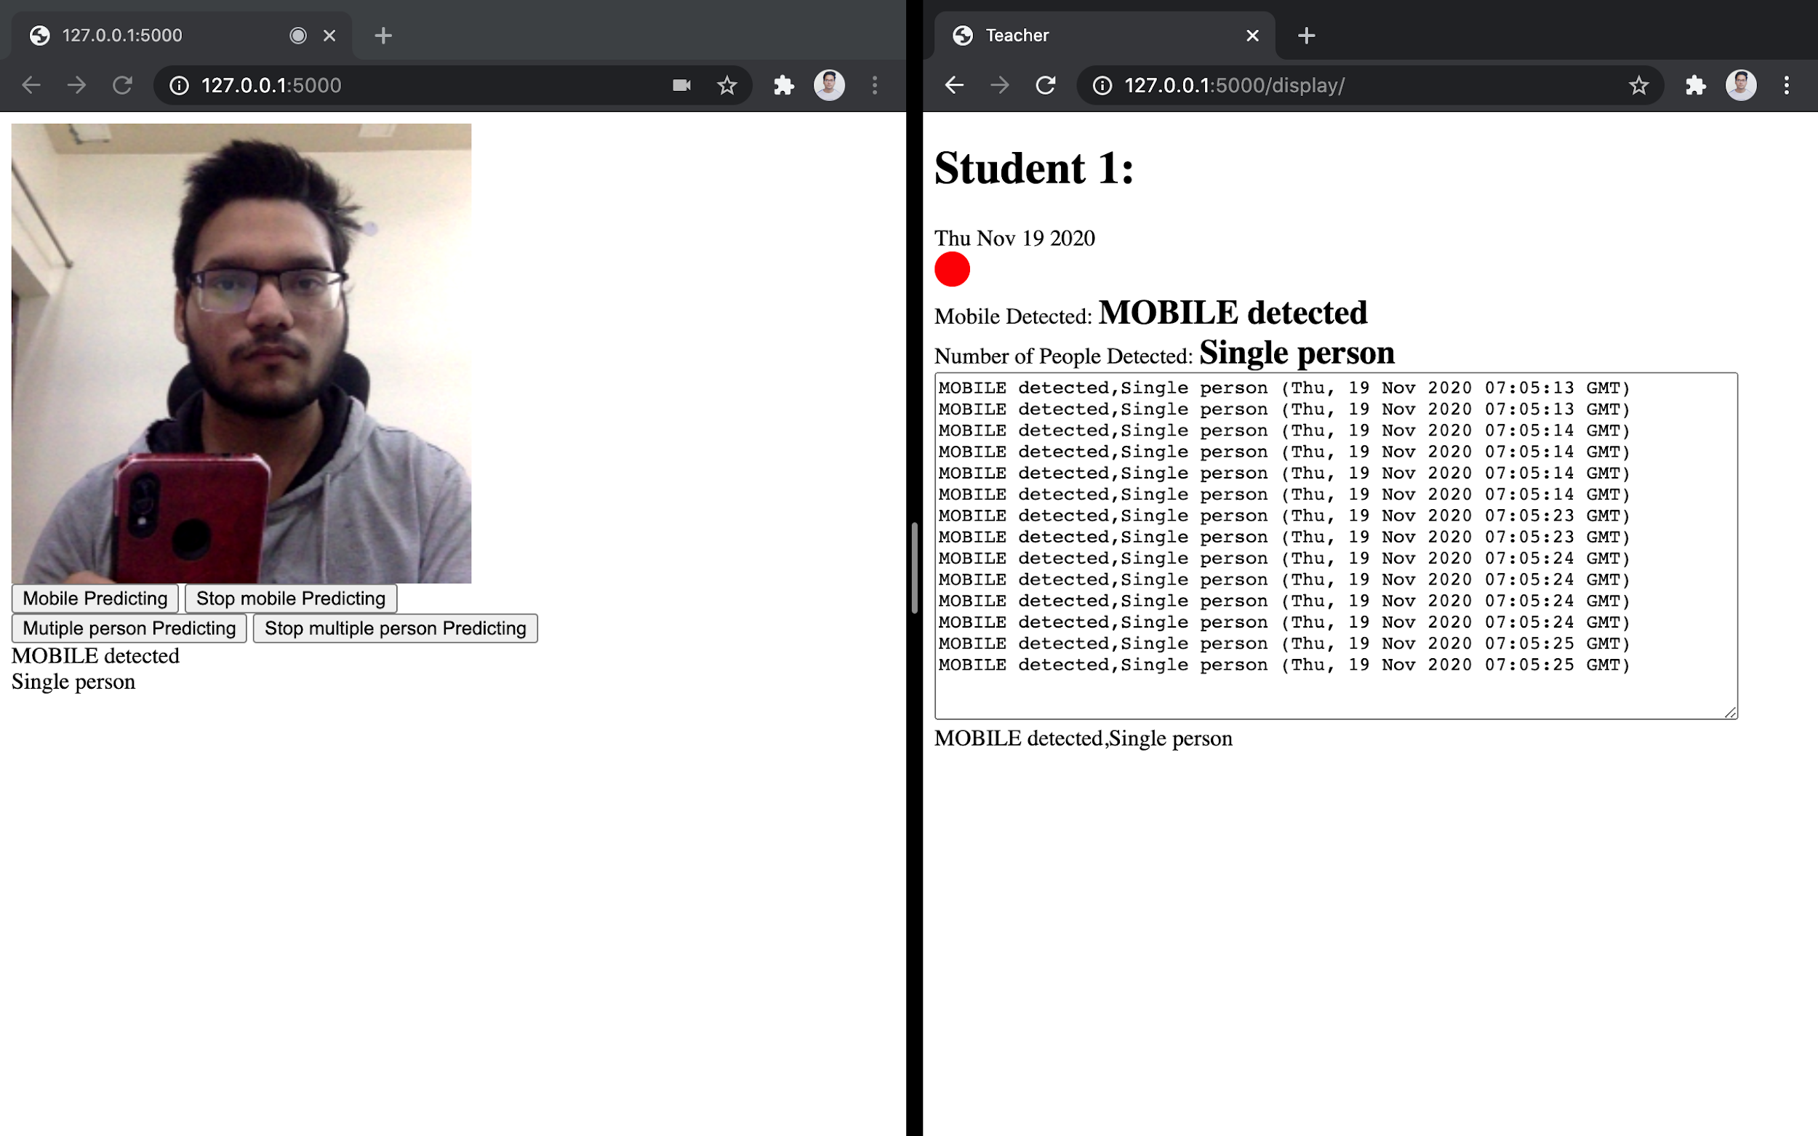
AI Assisted Alert System for Teachers

Slide 15
AI Assisted Alert System for Teachers
These models will automatically detect multiple sources (like mobile and multiple person) from where student can cheat.
The system will send alert with the student Id to the teacher when cheating flags are activated.
And if student found to cheat more than 5 times it will show red alert.

Slide 16

Hybrid Implementation

Slide 17
Hybrid Implementation
The hybrid implementation would allow institutions to efficiently use their infrastructure
By redirecting traffic from their own hardware to the cloud through smart load balancing the system would be crash-free when there is a sudden surge in the traffic at the time of exams

Slide 18
What next?
Integrate all these separate part of PARiKSHA.
Add more variety of questions like True/False, One Word, Even Short answer type to improve the quality of quiz.
Make the U.I. more reactive and responsive.
Add profile / class view for teacher and students.

